Slide 1
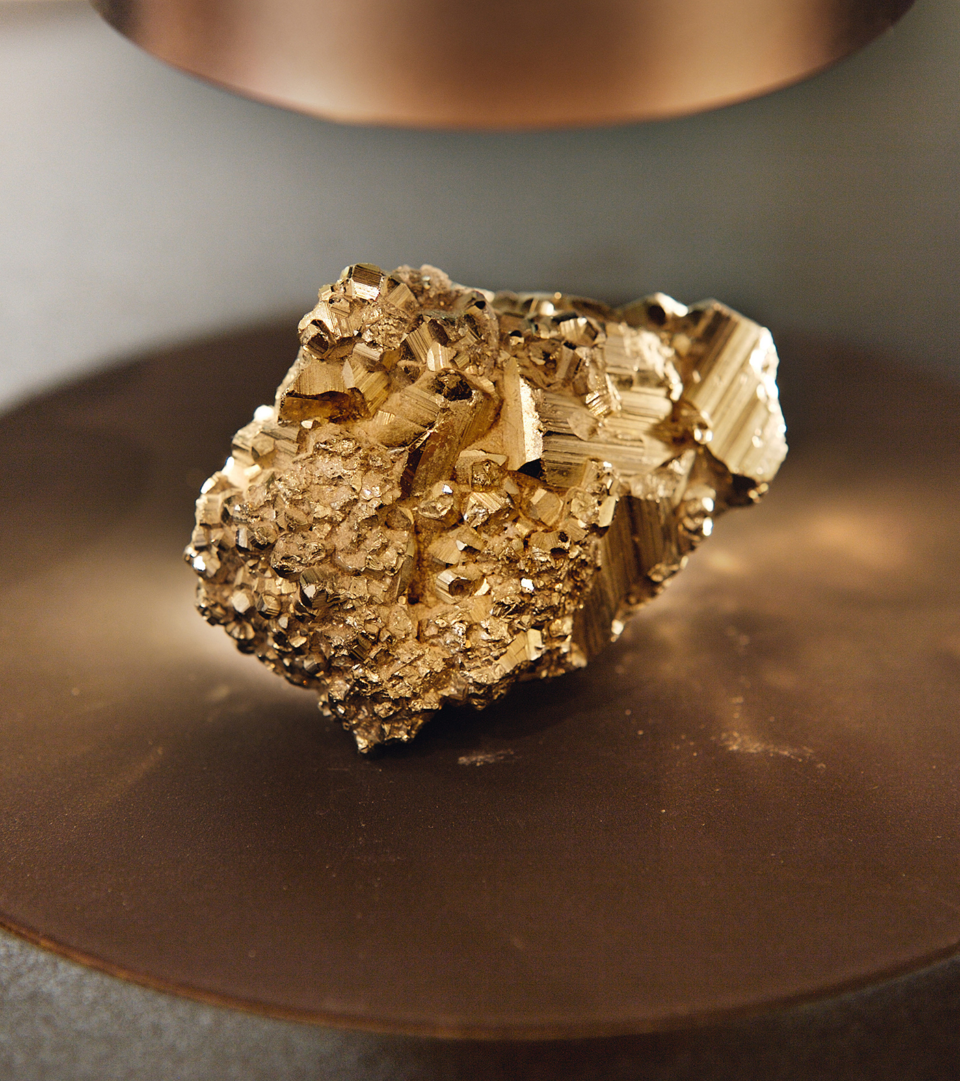

Chile at
A Glance
Monthly Rolling Economic Electronic Presentation
August 2025
britcham

Slide 2

t
Current Economic Performance
britcham

Slide 3
GDP Growth (% over same quarter previous year)
Current Economy
2023 |  |  |  | 2024 |  |  |  | 2025
QI | QII | QIII | QIV | QI | QII | QIII | QIV | QI | QII
-0.3 | -0.1 | 1.6 | 1.1 | 3,3 | 1.2 | 2.0 | 4,0 | 2.5 | 3.1
Source: Central Bank of Chile.

Slide 4
Inflation (%)
A Creative Agency for
Wine & Spirits
Current Economy
 | 2024 |  |  |  |  | 2025
 | Aug | Sep | Oct | Nov | Dec | Jan | Feb | Mar | Apr | May | Jun | Jul
Monthly variation | 0.3 | 0.1 | 1.0 | 0.2 | -0.2 | 1.1 | 0.4 | 0.5 | 0.2 | 0.2 | -0.4 | 0.9
12-monthly variation | 4.7 | 4.1 | 4.7 | 4.2 | 4.5 | 4.9 | 4.7 | 4.9 | 4.5 | 4.4 | 4.1 | 4.3
Source: National Statistics Institute (INE)

Slide 5
Unemployment (3-month rolling average.%)
A Creative Agency for
Wine & Spirits
Current Economy
2024 |  |  |  |  |  | 2025
Jul | Aug | Sep | Oct | Nov | Dec | Jan | Feb | Mar | Apr | May | Jun
8.7 | 8.9 | 8.7 | 8.6 | 8.2 | 8.1 | 8.0 | 8.4 | 8.7 | 8.8 | 8.9 | 8.9
Source: National Statistics Institute (INE).

Slide 6
Domestic Interest Rates (% annual rate, nominal)
Current Economy
 | 2024 |  |  |  | 2025
 | Sep | Oct | Nov | Dec | Jan | Feb | Mar | Apr | May | Jun | Jul | Aug
Reference rate | 5.50 | 5.25 | 5.25 | 5.00 | 5.00 | 5.00 | 5.00 | 5.00 | 5.00 | 5.00 | 4.75 | 4.75
Lending rate * | 18.74 | 18.35 | 15.73 | 13.61 | 14.39 | 16.51 | 16.45 | 13.38 | 14.48 | 13.45 | 13.88 | N/A
Borrowing rate * | 5.42 | 5.19 | 5.21 | 5.24 | 5.36 | 5.63 | 5.52 | 5.14 | 5.10 | 5.02 | 4.99 | N/A
*Loan/deposits with maturity of 1-3 years.
Source: Central Bank of Chile

Slide 7
Fiscal Balance (% of GDP)
A Creative Agency for
Wine & Spirits
Current Economy
2016 | 2017 | 2018 | 2019 | 2020 | 2021 | 2022 | 2023 | 2024 | 2025
-2.7 | -2.8 | -1.6 | -2.8 | -7.3 | -7.7 | 1.1 | -2.4 | -2.8 | -1.5
* Estimated by Ministry of Finance. July 2025.
Source: Ministry of Finance.

Slide 8
Selective Share Price Index (IPSA) (%)
A Creative Agency for
Wine & Spirits
Current Economy
 | 2024 |  |  |  |  | 2025
 | Aug | Sep | Oct | Nov | Dec | Jan | Feb | Mar | Apr | May | Jun | Jul
Monthly variation | 0.30 | 0.47 | 0.92 | 0.40 | 2.03 | 7.30 | 1.84 | 4.57 | 4.87 | 0.08 | 2.49 | -0.75
12-monthly variation | 7.50 | 11.27 | 21.13 | 13.03 | 8.27 | 20.25 | 13.68 | 15.41 | 23.48 | 21.33 | 28.59 | 27.10
Source: Santiago Stock Exchange.

Slide 9
Exports and Imports (monthly, US$ million)
A Creative Agency for
Wine & Spirits
Current Economy
 |  |  |  |  |  | 2025
 | Aug | Sep | Oct | Nov | Dec | Jan | Feb | Mar | Apr | May | Jun | Jul
Exportations | 7,995 | 7,798 | 8,306 | 7,862 | 9,511 | 10,431 | 7,956 | 8,661 | 8,956 | 8,490 | 8,290 | 8,144
Importations | 6,791 | 6,031 | 7,144 | 6,564 | 7,215 | 7,054 | 6,325 | 6,784 | 7,033 | 6,973 | 6,959 | 8,207
Source: Santiago Stock Exchange.

Slide 10
Quarterly Trade Balance, 2022-2025 (US$ million)
A Creative Agency for
Wine & Spirits
Current Economy
2022 |  | 2023 |  |  |  | 2024 |  |  |  | 2025
QIII | QIV | QI | QII | QIII | QIV | QI | QII | QIII | QIV | QI | QII
-1,046 | 3,804 | 6,333 | 2,797 | 1,147 | 3,532 | 6,935 | 5,262 | 4,079 | 4,756 | 6,883 | 4,771
Source: Central Bank of Chile

Slide 11
Copper Price (LME, monthly average, US$/lb)
A Creative Agency for
Wine & Spirits
Current Economy
 |  |  |  |  | 2025
Aug | Sep | Oct | Nov | Dec | Jan | Feb | Mar | Apr | May | Jun | Jul
4.07 | 4.20 | 4.33 | 4.12 | 4.05 | 4.07 | 4.23 | 4.40 | 4.18 | 4.32 | 4.43 | 4.46
Source: Cochilco.

Slide 12
Exchange Rate (Monthly average, pesos/US$)
A Creative Agency for
Wine & Spirits
Current Economy
2024 |  |  |  |  | 2025
Aug | Sep | Oct | Nov | Dec | Jan | Feb | Mar | Apr | May | Jun | Jul
930 | 926 | 934 | 972 | 982 | 1,001 | 957 | 933 | 962 | 941 | 938 | 952
Source: Central Bank of Chile

Slide 13
Summary of Central Bank Forecasts, 2025
A Creative Agency for
Wine & Spirits
Current Economy
GDP growth (%) | 2.00 – 2.75
Inflation (year-end, %) | 3.7
Trade balance (year-end, US$ million) | 21.300
Copper price (annual average, US$/lb) | 4.30
Current account balance (% of GDP) | -1.8
Source: Central Bank, Monetary Policy Report, June 2025.

Slide 14
Resumen de Pronósticos Privados, 2025*
A Creative Agency for
Wine & Spirits
Current Economy
GDP growth (annual, %) | 2.30
Inflation (annual, %) | 4.00
Reference interest rate (annual nominal %, year-end) | 4.50
Exchange rate (pesos/dollar) | 960
* Average private forecasts as surveyed by Central Bank, August 2025.

Slide 15
A Creative Agency for
Wine & Spirits
Informatión
Chile at a Glance
Background
britcham

Slide 16
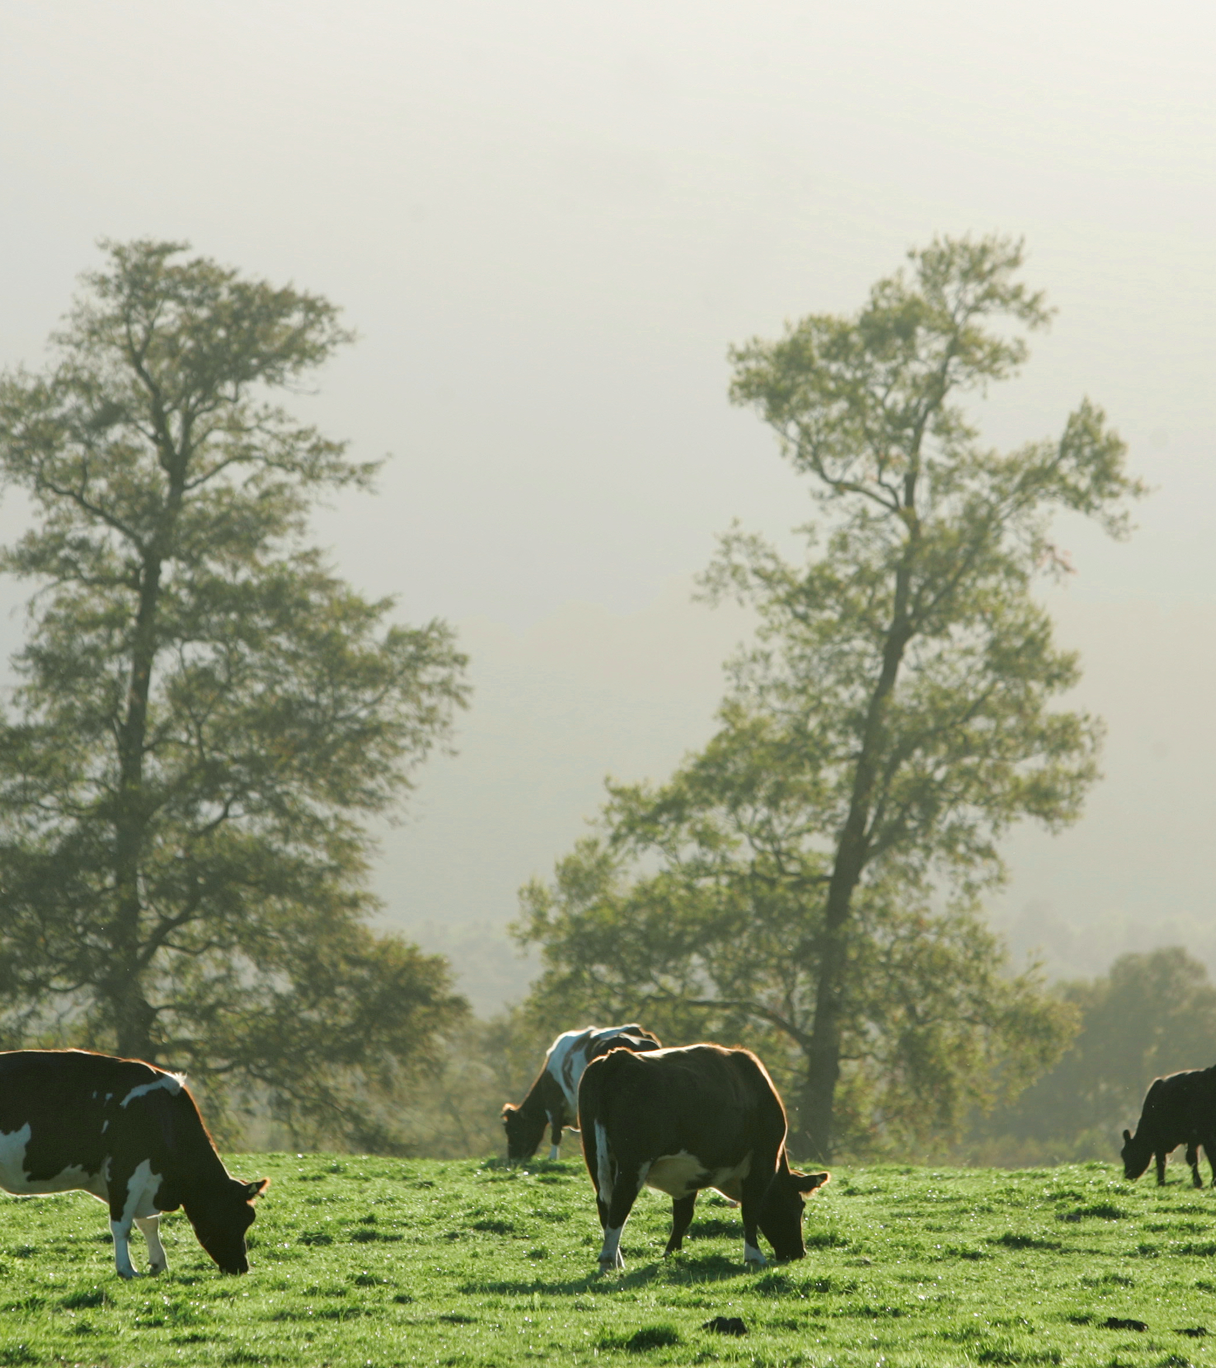

A Creative Agency for
Wine & Spirits
Background
Four main geographic areas with different economic activities:
North (Atacama Desert): mining, principally copper and nitrates
Central Valley, with Santiago (capital and seat of government) and Valparaíso (port and seat of Congress): manufacturing, agriculture, wine production and agribusiness
South: forestry, salmon farming, fishing, agriculture and, in Concepción, petrochemicals and steel production
Fjords and Tierra del Fuego: tourism, agriculture, fishing, gas and oil production, coal mining.
britcham

Slide 17
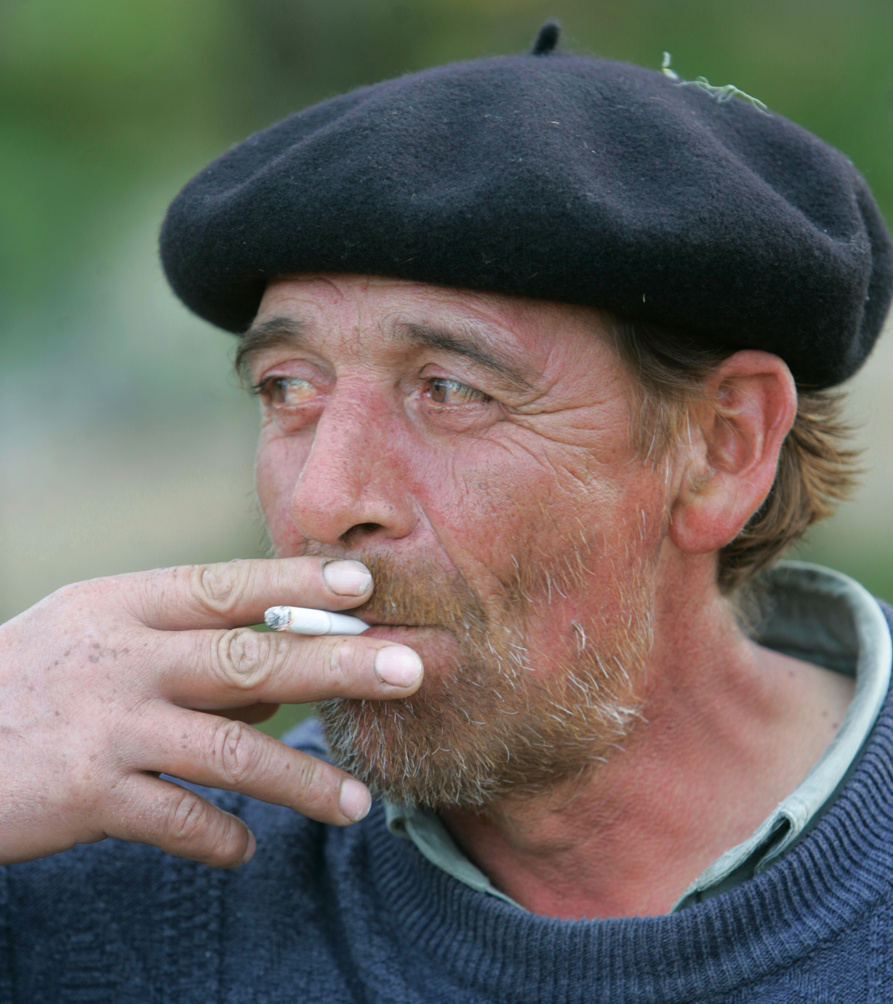
A Creative Agency for
Wine & Spirits
Background
The Chileans
Population: 20.2 millons (2025)
Language: Spanish
Literacy: 97% (2021)
Poverty: 6.5% (2022)
Life expectancy: 81,4 years (2024)
Indigenous population: 12.8%
britcham

Slide 18
Economy
A Creative Agency for
Wine & Spirits
Background
2015 | 2016 | 2017 | 2018 | 2019 | 2020 | 2021 | 2022 | 2023 | 2024
2.2 | 1.8 | 1.4 | 4.0 | 0.6 | -6.1 | 11.3 | 2.2 | 0.5 | 2.6
Source: Central Bank of Chile
GDP per capita (PPP) 2023 = US$32,893*
Labour force = 10.2 millons
* Estimated by World Bank..

Slide 19
Macroeconomic Framework
A Creative Agency for
Wine & Spirits
Background
Monetary Policy:
Autonomous Central Bank, responsible for means of payment and price level
Inflation-targeting policy: 2%-4% over 24-month horizon
Overnight interest rate set in nominal terms at monthly monetary policy meeting.
Fiscal Policy:
Structural fiscal rule in force since 2001
Government spending tied to structural (non-cyclical) income
Non-cyclical income calculated on basis of trend growth and expected copper price over next ten years (both estimated by committee of independent experts).

Slide 20
Macroeconomic Framework
A Creative Agency for
Wine & Spirits
Background
Exchange Rate Policy:
Floating exchange rate since 1999
Central Bank retains right to intervene directly in foreign currency market in case of severe fluctuations
No capital controls.
Trade Policy:
Open economy
34 trade agreements with 65 countries, including Free Trade Agreements with main trading partners
Flat-rate tariff of 6% on imports from other countries.

Slide 21
Macroeconomic Framework
A Creative Agency for
Wine & Spirits
Background
FDI Policy:
The 2015 Foreign Direct Investment Law guarantees investors the right to transfer profits abroad, access to the foreign exchange market and non-discrimination versus local investors.
Semi-integrated tax system: corporate tax serves as credit against withholding tax
Double taxation avoidance agreements in force with 37 countries.

Slide 22
International Rankings
A Creative Agency for
Wine & Spirits
Background
UN Human Development Report 2025
1 | Iceland
2 | Norway
3 | Switzerland
13 | United Kingdom
28 | Spain
45 | Chile
47 | Argentina
79 | Peru
84 | Brazil
World Competitiveness Yearbook 2025
1 | Switzerland
2 | Singapore
3 | Hong Kong
29 | United Kingdom
42 | Chile
54 | Colombia
55 | Mexico
58 | Brazil
Source: UNPD
Source: Institute for Management Development

Slide 23
SOVEREIGN RISK
A Creative Agency for
Wine & Spirits
Background
Chile’s Sovereign Ratings
(August 2025)
Fitch Ratings | A- (stable)
S&P Global Ratings | A (Stable)
Moody’s | A2 (Stable)
JCR | AA- (stable)

Slide 24
International Trade
A Creative Agency for
Wine & Spirits
Background
 | 2015 | 2016 | 2017 | 2018 | 2019 | 2020 | 2021 | 2022 | 2023 | 2024
Copper | 30.0 | 27.9 | 34.0 | 35.6 | 32.6 | 38.5 | 52.5 | 43.8 | 42.6 | 49.7
Total | 62.1 | 60.8 | 68.9 | 74.8 | 68.8 | 74.0 | 94.6 | 98.5 | 93.0 | 99.2
Source: Central Bank of Chile.

Slide 25
International Trade
A Creative Agency for
Wine & Spirits
Un Vistazo de Chile
 | 2015 | 2016 | 2017 | 2018 | 2019 | 2020 | 2021 | 2022 | 2023 | 2024
Consumer goods | 18.1 | 18.1 | 21.0 | 22.9 | 20.2 | 16.3 | 27.6 | 28.5 | 22.0 | 22.8
Oil & Other fuels | 7.9 | 6.9 | 8.8 | 11.2 | 10.5 | 6.8 | 12.6 | 20.3 | 15.9 | 14.2
Non-oil inputs | 22.6 | 20.9 | 21.8 | 25.2 | 24.0 | 22.5 | 33.5 | 36.1 | 30.1 | 30.5
Capital goods | 13.7 | 13.5 | 13.5 | 15.3 | 15.2 | 13.6 | 18.7 | 19.8 | 17.3 | 16.7
Total | 62.3 | 59.3 | 65.2 | 74.6 | 70.0 | 59.2 | 92.4 | 104.7 | 85.3 | 84.3

Slide 26
International Trade
A Creative Agency for
Wine & Spirits
Background
Main Trading Partners, 2024
Exports |  | Imports
US$ billion |  | US$ billion
China | 38.2 | China | 19.3
United States | 15.5 | United States | 14.8
Japan | 8.6 | Brazil | 7.0
South Korea | 4.7 | Argentina | 6.6
Chile-UK Trade 2018-2024 (US$ million)
 | Exports to UK | Imports from UK
2018 | 677 | 640
2019 | 623 | 558
2020 | 575 | 482
2021 | 571 | 584
2022 | 616 | 564
2023 | 458 | 489
2024 | 551 | 529

Slide 27
A Creative Agency for
Wine & Spirits
Information
Feedback / Comentarios:
Por favor contactar vía email isabel.juppet@britcham.cl
britcham

